Slide 1

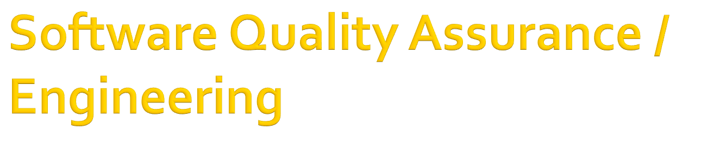
In the name of Allah, the Beneficent, the Merciful
CSC312 / CSE312
Lecture 3: Software Quality Assurance in Context

Slide 2

“A systematic, planned set of actions necessary to provide adequate confidence that the software development process or the maintenance process of a software system product conforms to established functional technical requirements as well as with the managerial requirements of keeping the schedule and operating within the budgetary confines”

Slide 3

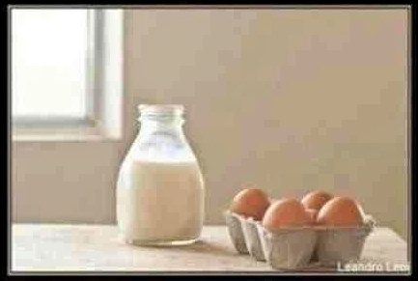
My Mom said,
"Please go to the market and buy one bottle of milk, if they have eggs, bring 6".
I came back with 6 bottles of milk
She said, "Why the hell did you buy 6 bottles of milk?"
I replied, "BECAUSE THEY HAD EGGS!!"

Slide 4

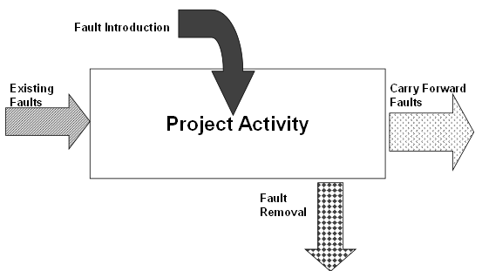
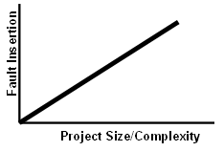

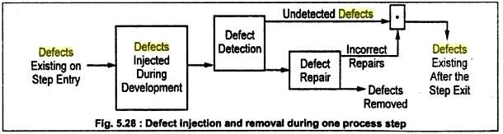

Slide 5
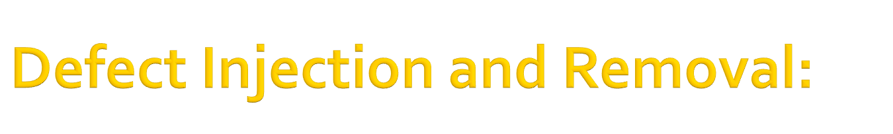
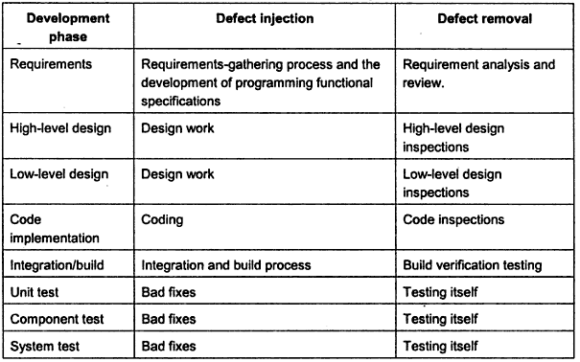

Slide 6

We can view different QA activities as attempting to prevent, eliminate, or contain various types of defects
The QA alternatives can be classified into three large categories
  Defect Prevention
  Defect Reduction
  Defect Containment

Slide 7

  Defect Prevention
    avoid certain types of faults from being injected into the software. Train engineers, Use formal methods
  Defect Reduction
    detect and remove certain faults once they have been injected into the software systems
    Inspection, testing
  Defect Containment
    focus on the failures by either containing them to local areas, or limiting the damage caused by software system failures

Slide 8

If human misconceptions are the error sources, education and training can help us remove these error sources
If imprecise designs and implementations that deviate from product specifications or design are the causes for faults, formal methods can help us prevent such deviations.
If certain tools or technologies can reduce fault injections under similar environments, they should be adopted

Slide 9

Faults are detected directly in inspection by human inspectors
Identified faults need to be removed as a result of the inspection process, and their removal also needs to be verified
Software testing is a dynamic way of detecting faults in the program through program execution

Slide 10

Sometimes software are extremely large and development time is limited
Code inspections and testing can only detect a certain amount of defects
Software is delivered with some defects due to insufficient time for complete testing
Defect containment techniques like software fault tolerance can be used in such cases

Slide 11

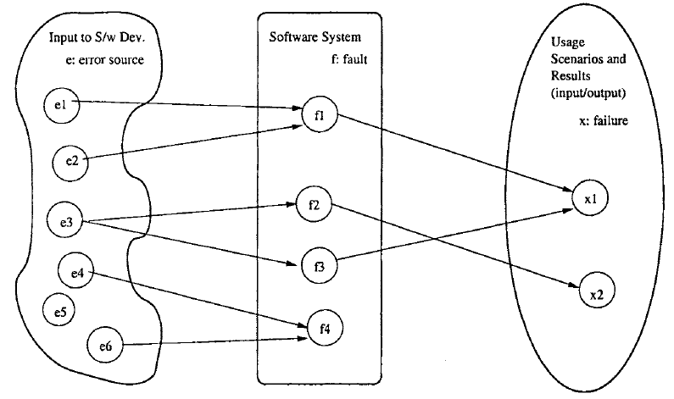

Slide 12

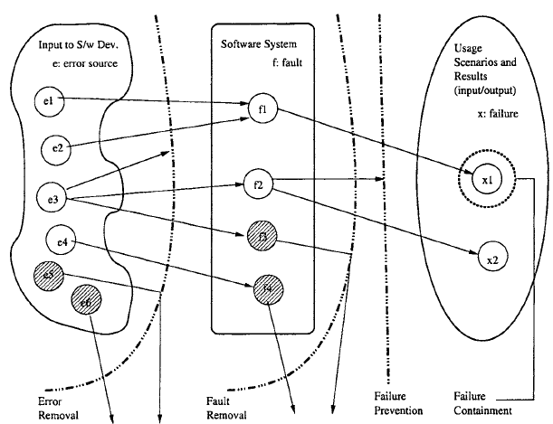

Slide 13
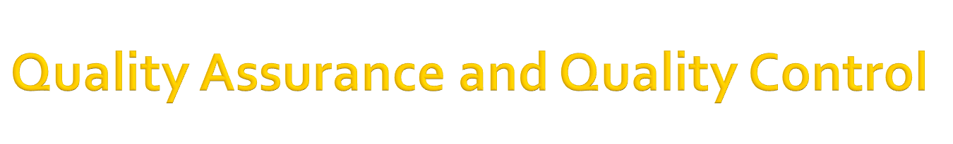
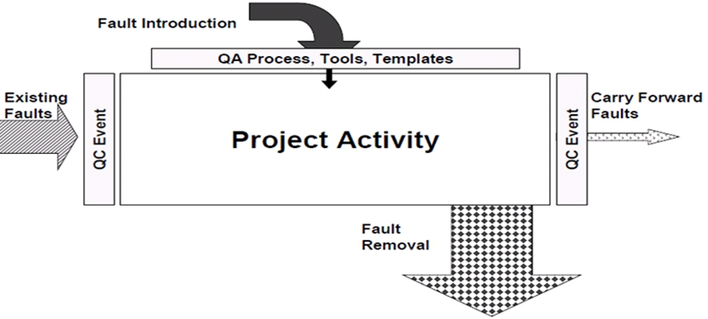

Slide 14

Quality Assurance (QA) is fault prevention through process design and auditing
  Things done before starting to develop software & related products
  Creating processes, procedures, tools, etc. to prevent faults from occurring (Templates, checklists)
  Recruit Good People, Identify standards, Processes, Tools, Train People to use Processes & Tools
  Main goal: prevent as much as possible defect injection

Slide 15

Quality Control (QC) is fault/failure detection through static and/or dynamic testing of artifacts
  Things to be done after developing software & related products
  Since Software development is a human dominating activity and humans are error prone, some errors will occur
  Examining the artifact against pre-determined criteria to measure conformance

Slide 16
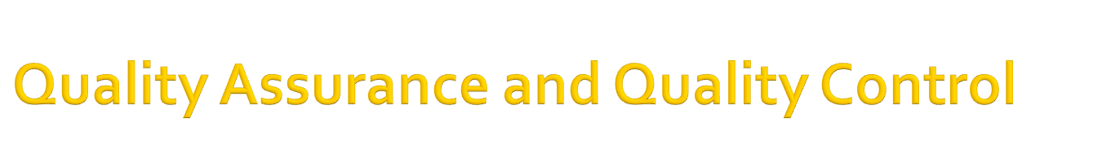
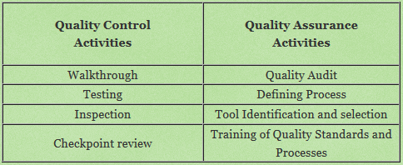
Notes:
A review held to determine whether the software development project's plan, requirements analysis, and initial architecture work is sufficient to continue further development. A go/no go decision is made about 10 to 20 percent into this first phase. At many companies checkpoint review is called gate review
The departments or employees of a firm that perform the core activities and contribute to its business directly are called line function example manufacturing and marketing. on the other hand the departments or employees that perform the support function and contribute indirectly to the business of a firm are termed as staff function example Human Resource Management and Finance.

Slide 17

The most important activity associated with defect handling is defect resolution
Each corrected or fixed defect needs to be re-verified to ensure failure-free executions under the same execution conditions
To support defect resolution, two other important activities are
  Defect logging, or the initial reporting and recording of a discovered defect
  Defect tracking, which monitors and records what happened to each defect after its initial discovery

Slide 18

Waterfall activities include product planning, requirement analysis, specification, design, coding, testing, release, and post-release product support
As a central part of QA activities, testing is an integral part of the waterfall development process
Other QA activities can be carried out in other phases and in transition from one phase to another
  Part of the criteria to move on from each phase to the next is quality, typically in the form of checking to see if certain quality plans or standards have been completed

Slide 19

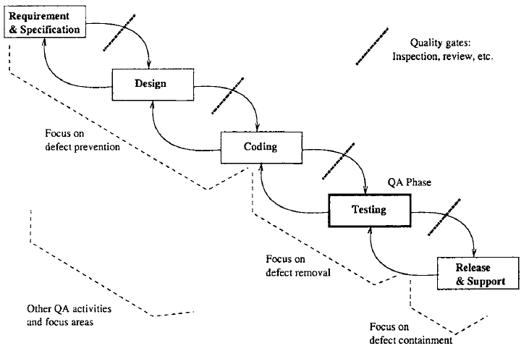

Slide 20

The user wants a software performs the right functions as specified, and performs them correctly
To ensure that the right functions are performed are typically grouped as validation activities
To ensure the correct or reliable performance of these specified functions are typically grouped as verification activities
The three types of QA activities can be mapped into this binary partition of validation and verification activities using the related defects

Slide 21

QA activities for validation include;
  System testing, where the focus is the overall set of system functions to be provided to users;
  Acceptance testing and beta testing, where the focus is the assessment of software acceptance or performance by users
  Usage-based statistical testing, where the operational environment by target users is simulated during software testing before product release
  Software fault tolerance, which focuses on providing continued service even when local problems exist

Slide 22
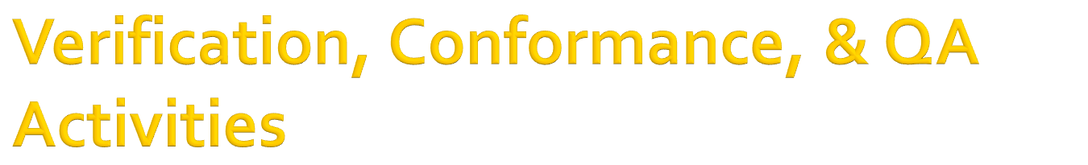
When a function or feature expected by the customers is present, the activity to determine whether it performs expectedly is called verification
All validation activities, include corresponding verification components
A wrong algorithm or an inappropriate data structure, violation of some coding standard are associated with various types of software faults
All the QA activities we classified as dealing directly with faults, errors, or error sources can be classified as verification activities

Slide 23
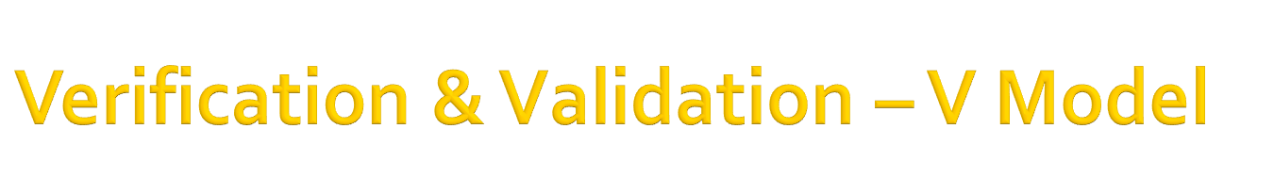
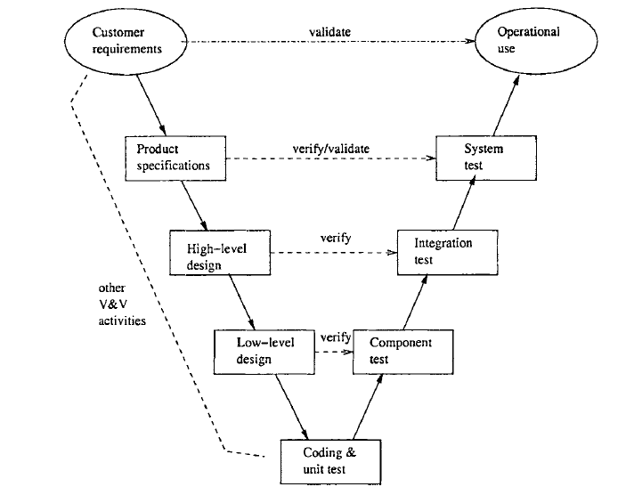

Slide 24

Summary

